Slide 1
Data Science & Devops

Slide 2
Agenda
What is Data Science.
Relationship to statistics.
Impact of Data Science.
Data science workflow
Why data scientists need to know about DevOps?
Data science development infrastructure.
Data Science deployment.
By: Elsayed Ahmed Elwasefy

Slide 3
Data Science

Slide 4
What is Data Science?
Data science is a multi-disciplinary field that uses (scientific methods, processes, algorithms and systems) to extract knowledge and insights from many structural and unstructured data which are typically large.
Data science is related to data mining, machine learning and big data.

Slide 5
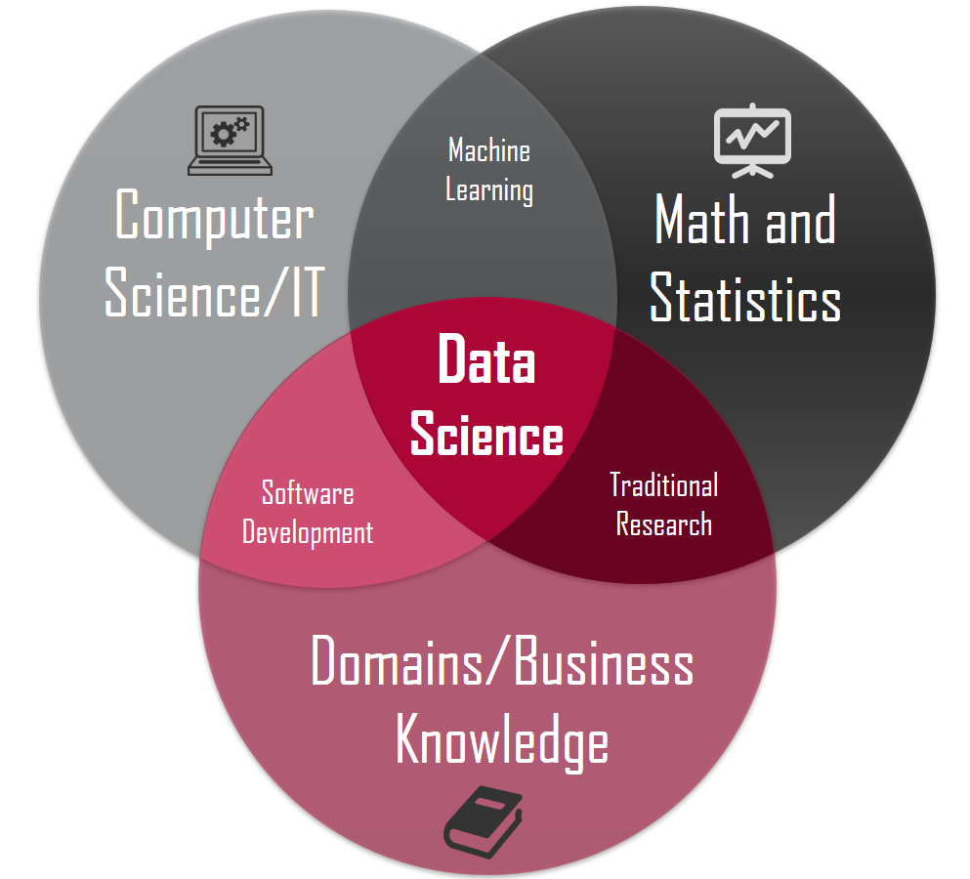
What is Data Science?
A concept to unify statistics, data analysis, machine learning and their related methods in order to understand and analyze actual phenomena with data
Employs techniques and theories drawn from many fields within the context of mathematics, statistics and computer science

Slide 6
Relationship to statistics
Many statisticians, have argued that data science is not a new field, but rather another name for statistics.
Others argue that data science is distinct from statistics because it focuses on problems and techniques unique to digital data.
Andrew Gelman a data scientist has described statistics as a nonessential part of data science.
Finally it is described as an applied field growing out of traditional statistics.

Slide 7
Impacts of data science
Big data is very quickly becoming a vital tool for businesses and companies of all sizes.
Data-driven businesses are worth $1.2 trillion collectively in 2020, an increase from $333 billion in the year 2015.

Slide 8
Data scientist need to be comfortable with:
Mathematics:
Linear Algebra, Calculus, Graph Theory and Probability.
Software Engineering:
Algorithms and data structures.
Machine Learning

Slide 9
Data Science Steps
Data Gathering: structured and unstructured data.
Data Preparation: Once Getting data, clean and format.
Exploration: Get some insights, visualize, apply clustering algorithms to understand this data to aid you in building a model step
Building Model

Slide 10
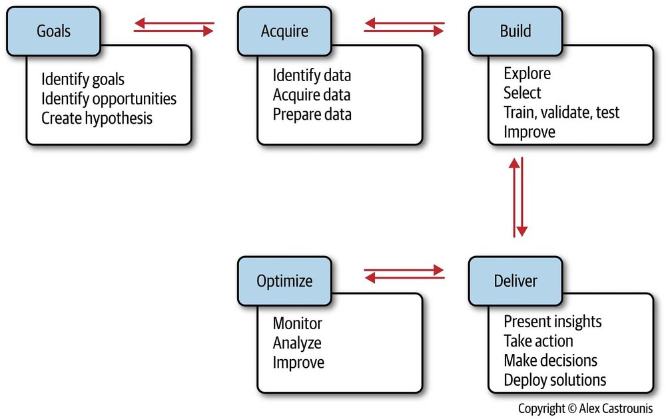
Data Science Workflow

Slide 11
Data Science VS Business Intelligence
Perhaps the easiest way to differentiate is to think of:
Data science in terms of the future.
BI in terms of the past and present.

Slide 12
The Art Of Data Science
Volume, Velocity, Variety (3 V’s)
Volume: A good data scientist will be adept at managing volume not just technically in a database sense, but by building algorithms to make intelligent use of the size of the data as efficiently as possible.

Slide 13
The Art Of Data Science
Volume, Velocity, Variety (3 V’s)
Velocity: is the measure of how fast the data is coming in.
Facebook has to handle a tsunami of photographs every day. It has to ingest it all, process it, file it, and somehow, later, be able to retrieve it.

Slide 14
The Art Of Data Science
Volume, Velocity, Variety (3 V’s)
Variety: Different forms of data,
you may deal with photographs, tweets, plain texts, and so on. Each of these are very different from each other.

Slide 15
The Art Of Data Science
Machine Learning:
is about how systems learn from data.
Systems may be trained on data to make decisions, and training is a continuous process, where the system updates its learning and (hopefully) improves its decision-making ability with more data.
As we feed it more data it keeps changing its decision rules

Slide 16
The Art Of Data Science
Supervised and Unsupervised Learning (systems may learn in two broad ways) :
Supervised Learning:
A system produces decisions (outputs) based on input data.
Automated credit card approval systems is an example of this type of learning.
The system is given a historical data sample of inputs and known outputs, and it “learns” the relationship between the two using machine learning techniques.

Slide 17
The Art Of Data Science
Supervised and Unsupervised Learning (systems may learn in two broad ways) :
Unsupervised Learning:
is a process of reorganizing and enhancing the inputs in order to place structure on unlabeled data.
Example: is cluster analysis, which takes a collection of entities, each with a number of attributes, and partitions the entity space into sets or groups based on closeness of the attributes of all entities.

Slide 18
Data Science Goals and Deliverables
Here is a short list of common data science deliverables:
Prediction (predict a value based on inputs)
Classification (e.g., spam or not spam)
Recommendations (e.g., Amazon, Wuzzuf and Netflix recommendations)
Pattern detection and grouping
Recognition (image, text, audio, video, facial, …)

Slide 19
Data Science Goals and Deliverables
Here is a short list of common data science deliverables:
Actionable insights (via dashboards, reports, visualizations, …)
Automated processes and decision-making (e.g., credit card approval)
Optimization (e.g., risk management)
Forecasts (e.g., sales and revenue)

Slide 20
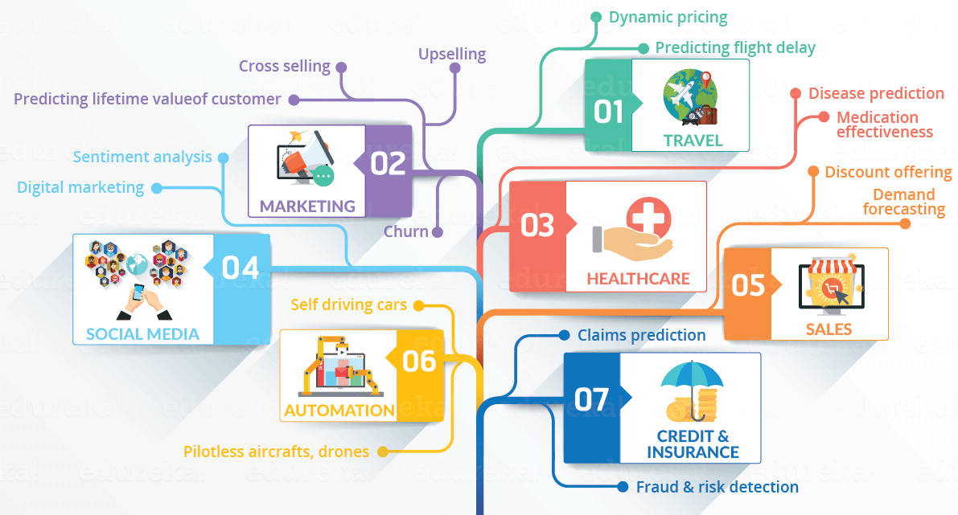
Use Cases:

Slide 21
Applying devops in data science

Slide 22
Why data scientists need to know about DevOps?
Software developers needed to move fast and experiment often,
while Operations teams prioritized stability and availability of services (these are the people who keep servers running day in and day out).
Their goals were not only opposing, they were competing.
Data scientists create value by experiments: new ways of modeling, combining, and transforming data.

Slide 23
Devops requirements for data scientists differ from application developers
They perform more experimentation around data sets and models, it’s in role require plan, build, test, deploy cycle.
Developing and testing models vary in machine levels.
Auto scale depending on data size and the model used.
Models deployed into production also require ongoing maintenance, so need new configurations
Monitoring data pipelines and models.

Slide 24
Development Environment
Preparing infrastructure:
Programing language (Python, R, or other languages)
What tools (Jupyter, Tableau, Apache Kafka, and NLTK) for analysis and modeling.
What databases and clouds are they using as data sources.
Code Management:
Where to store code.
How code is versioned.
How code is packaged for deployment.

Slide 25

Deployment
Implementing Continuous Integration:
removes some of the manual work
in testing new algorithms.
Configure tools like Jenkins
or other tools.

Slide 26
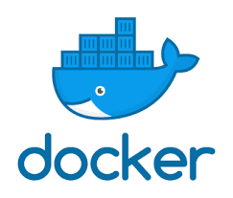
Deployment
Applying containerization (Docker)

Slide 27
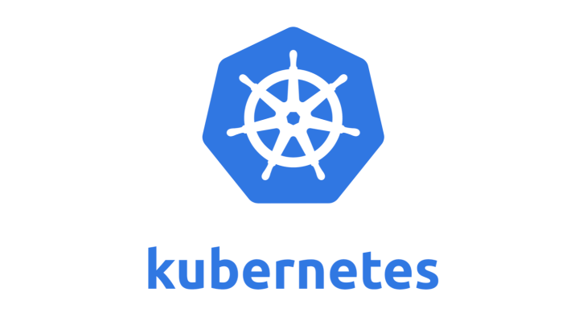
Deployment
Orchestration tools such as Kubernetes.

Slide 28

Thank You
You can find me at
elsayed.ahmed.elwasefy@gmail.com
01068379284

